Slide 1
Tensorflow basic (1/2)

Slide 2
What is Tensorflow?
Software framework for numerical computations based on dataflow graphs
Quite suitable for implementing machine learning algorithms, especially, deep learning algorithms.
Executable across a variety of environments and hardware platforms
Android, iOS, Raspberry Pi, ..
Linux, macOS, Windows, …

Slide 3
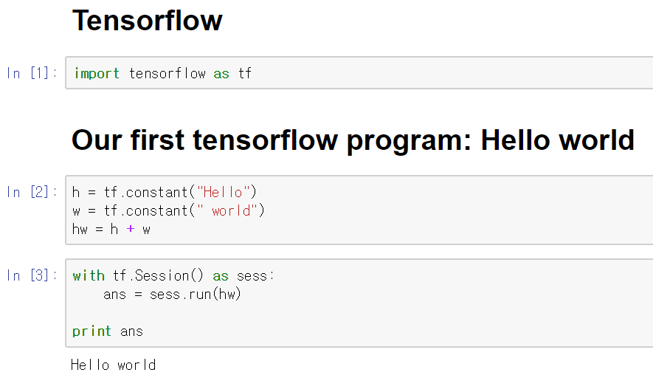
Hello world – Our first tensorflow example
Import Tensorflow package
Import tensorflow as tf
Constant variables and Operations
H = tf.constant(‘hello’)
W = tf.constant(‘ world’)
HW = tf.add(H, W) or = H + W
Execution
Session
Session.run()

Slide 4
Understanding Tensorflow Basics
a
b
Graphs
Nodes
Edges
Computation Graphs
Operations = Nodes
Tensors = Edges
The benefits of graph computation
Dependency analysis
Redundant elimination
c
d
c = a + b
a
c
e
e = c * d
b
d
d = a - b

Slide 5
Understanding Tensorflow Basics
Tensorflow workflow:
constructing computation graph
executing the graph
How to create computation graph
Right after we import tensorflow, a specific, empty graph is formed or
g = tf.Graph() creates a new graph
How to add nodes to graphs
All nodes created are automatically added to the default graph or
Use ‘g.as_default():’ to add nodes to new graphs

Slide 6
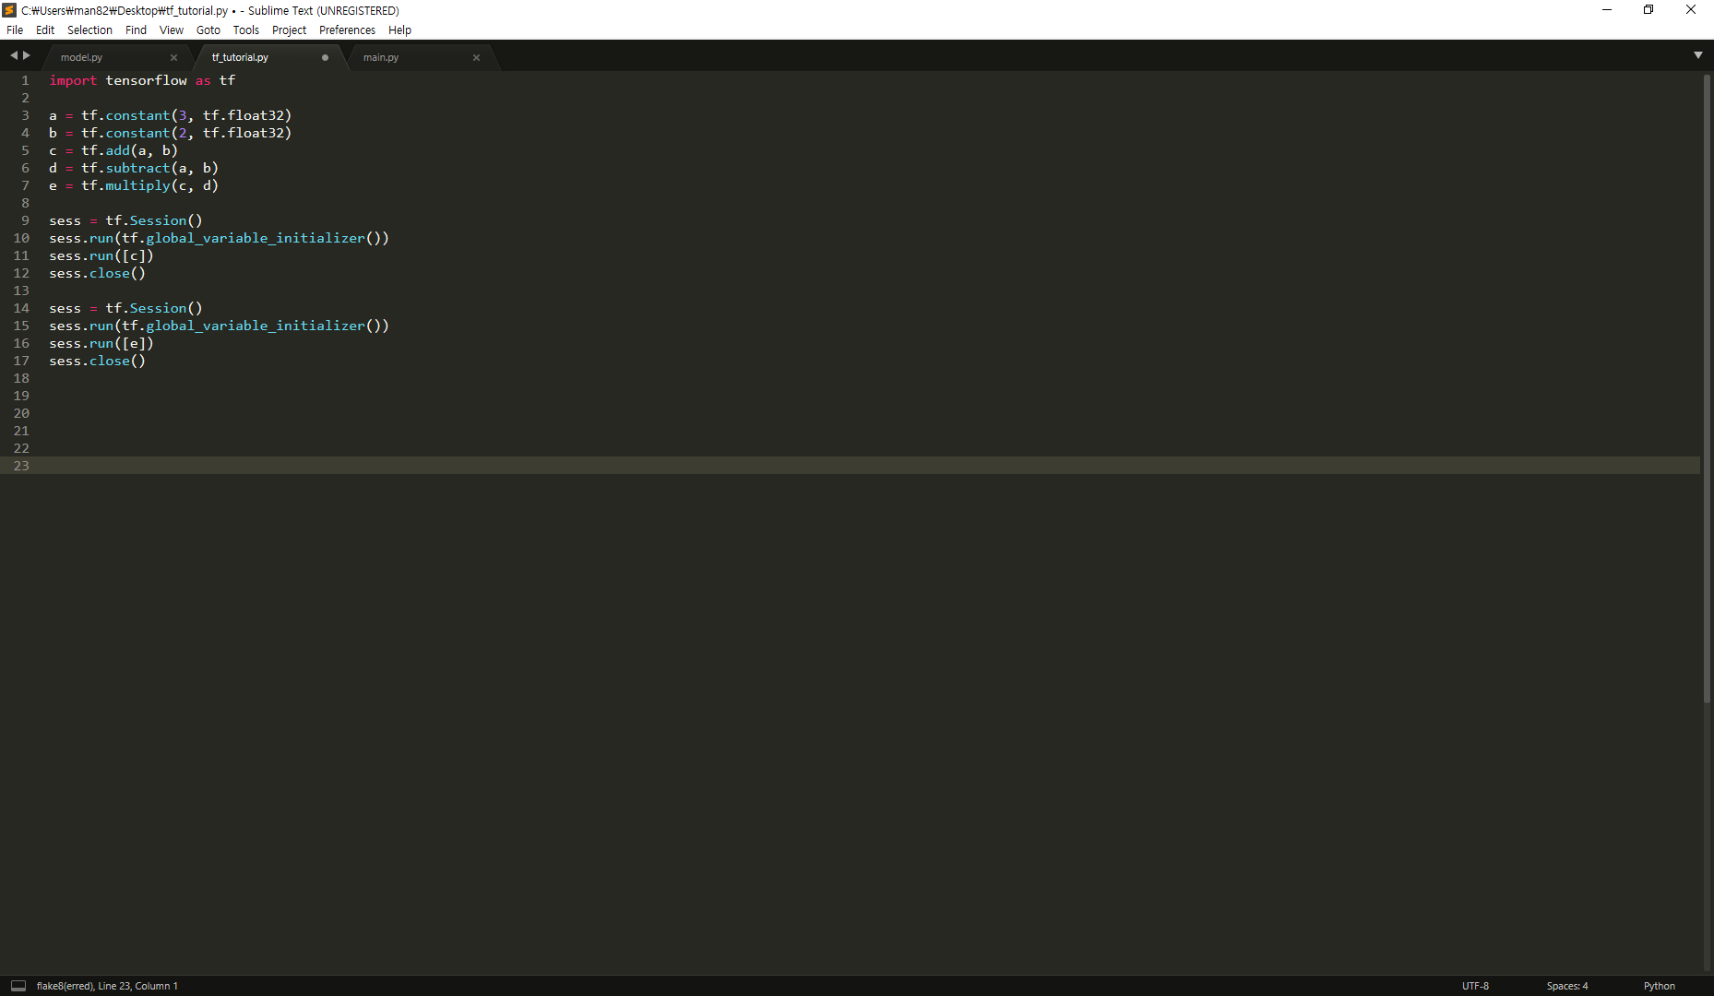
Understanding Tensorflow Basics
However, until executing graphs, operations do not produce values
How to execute the computation graphs
Sessions – execute graphs or part of graphs, resource managements
Fetches – Operations to execute
From the fetches, tensorflow finds dependencies among nodes and specifies graph or part of graph to execute.
Fetches
a
c
e
b
d

Slide 7
Understanding Tensorflow Basics
Tensor
An object used in the Python API as a handle for the result of an operation in the graph.
Mathematical term for n-dimensional arrays.
[1 x 1] tensor = scalar
[1 x n] tensor = array
[m x n] tensor = matrix
[m x n x k] tensor = 3-dimensional array
…
Tensorflow automatically infer the shape of the data

Slide 8
Understanding Tensorflow Basics
Name of tensor objects, data type
c1 = tf.constant(4, dtype=tf.float32, name=‘c’)
c2 = tf.constant(3, dtype=tf.float32, name=‘c’)
print c1.name → c:0
print c2.name → c_1:0
operation name
dtype
Python variables
Tensor object name
The name of tensor object is simply corresponding operation name concatenated with a colon,
followed by the index of that tensor in the outputs of the operation that produce it.

Slide 9
Understanding Tensorflow Basics
Name scope
Hierarchical node grouping for dealing with a large, complicate graph
with tf.name_scope(“scope_name”):
Variable
tf.Variable(initializer = …, dtype = …, name = …, …)
Used for parameters such as weights, biases which are tuned for optimization
Should be accommodated with tf.global_variables_initializer(), which allocates the memory and sets initial values.
Placeholders
Empty variables that will be filled in execution time
Filled with sess.run(op, feed_dict={X:x_data, Y:y_data})

Slide 10
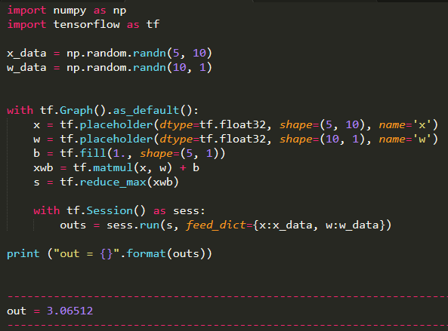
Understanding Tensorflow Basics

